Slide 1

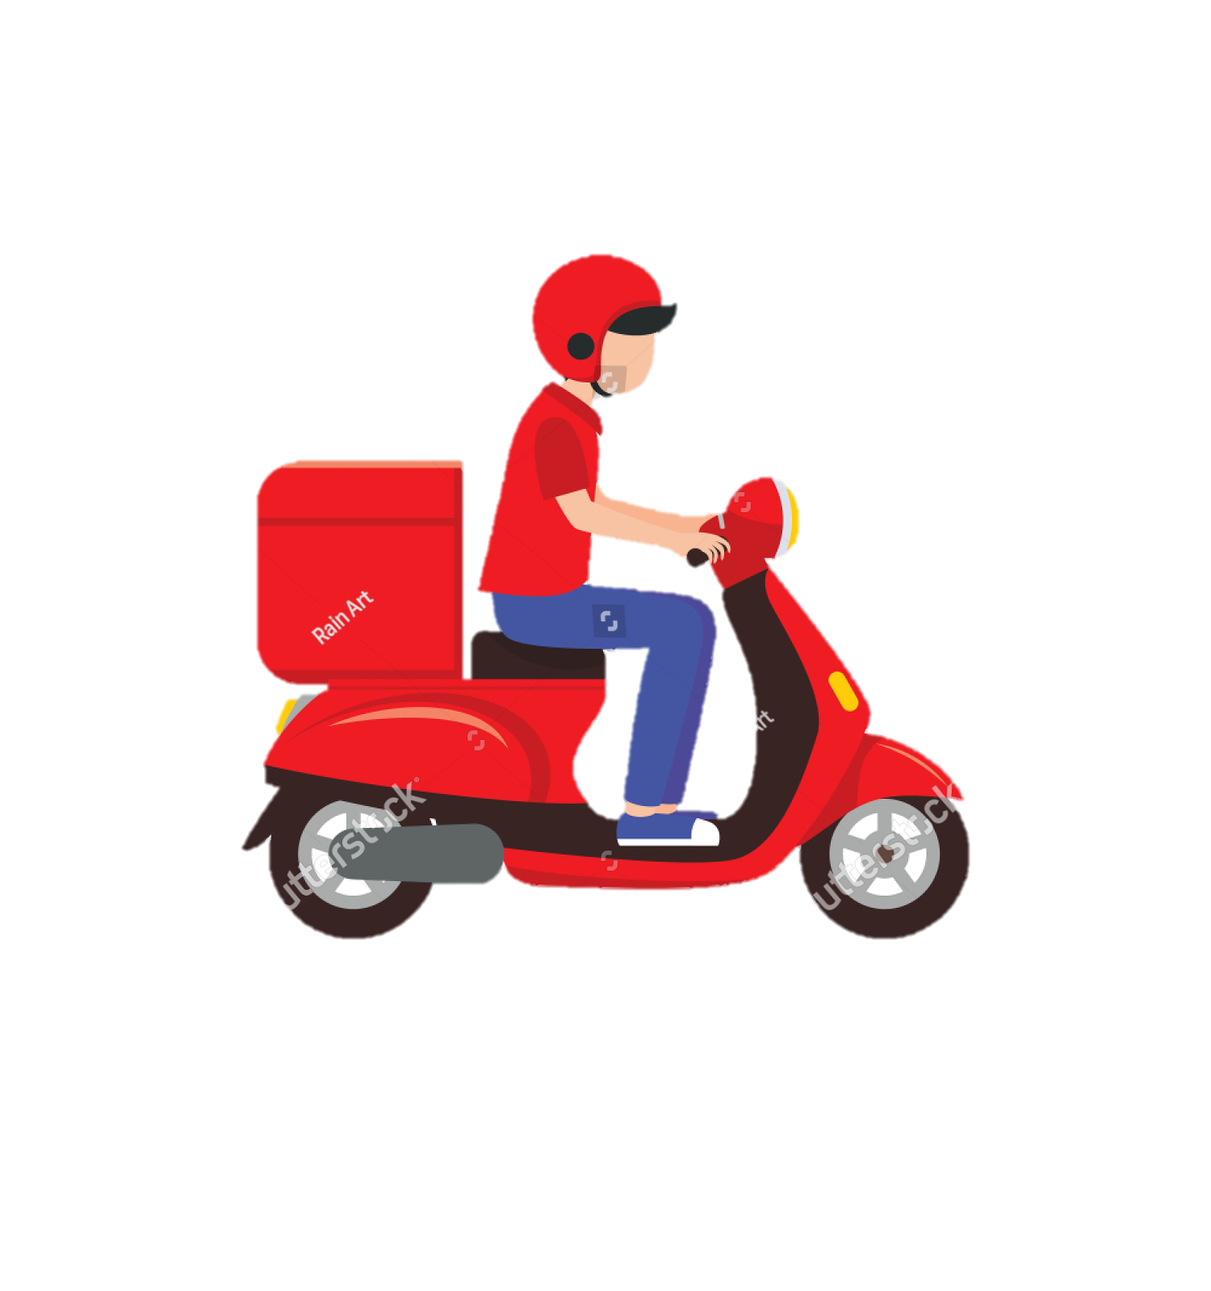

Slide 2

introduction
This presentation provides how to expand the ZOMATO RESTUARANTS all over the world. We have to analyzed the keys and we have to share some strategic move for the company’s future success.
Understanding the competitor strategies, Customer satisfactions, market trends and expenditures . It will help for the Zomato’s growth.

Slide 3
PROBLEM STATEMENT
You are hired as a consultant data analyst by Zomato where the team is looking for expansion and opening restaurants. Your task is to come up with strategies/suggestions about opening newer restaurants.

Slide 4
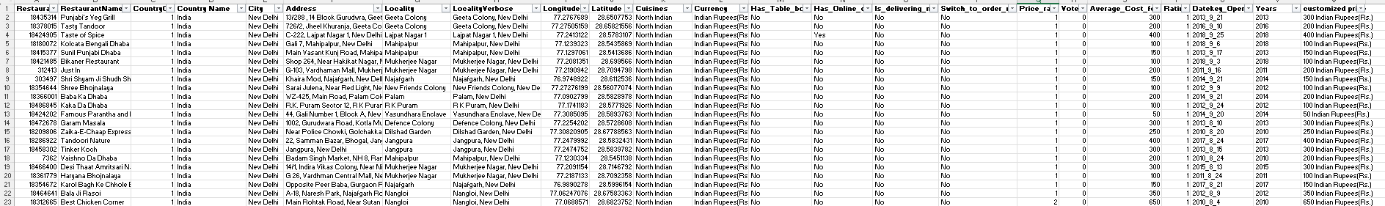
DATA OVERVIEW :-
The dataset encompasses 20 columns, including essential information such as restaurant ID, country code, longitude, and latitude.
Spans across 15 different countries, showcasing the international presence of Zomato's restaurants.
A grand total of 9,551 restaurants are included in the dataset, offering a comprehensive view of Zomato's global culinary landscape.

Slide 5
ANALYSIS – OPENING NEW RESTAURANT
Analyzing Countries with less competition
States and Cities for opening new restaurant
Rating – in the suggested country
Total expenditure on food – in the suggested country
Competitors
Cuisines
Online delivery / table booking
Restaurants in different price range
Dashboard

Slide 6
Data Pre-processing
Data Pre-processing Summary:
Country Name Extraction:
Utilized the VLOOKUP function to map country codes to their respective names, enhancing the interpretability of the dataset.
Date Transformation:
Extracted years from the complete date information, providing a clearer temporal dimension for analysis.

Slide 7
METHODOLOGY
Data Cleaning: Utilized functions like TRIM, CLEAN, and Remove Duplicates to ensure data accuracy.
Data Enrichment: Enhanced the dataset with additional variables using VLOOKUP to cross-reference external data sources. Also extract the Years from the Date for year wise analysis.
Descriptive Analysis: Created Pivot Tables for summarizing key metrics and identifying different trends and patterns in the restaurants data.
Visualization: Created dynamic charts and dashboards for data representation, enabling interactive data exploration

Slide 8
KEY POINTS
TOTAL COUNTRY - 15
TOTAL RESTAURANT – 9551
TOTAL CUISINES – 1825
TOTAL VOTES – 1498645
TOTAL CITIES - 376

Slide 9
SUGGESTED COUNTRY
The selection of countries has been done on the basis of two factor:
Less Competition
2.The ratings are average in the countries – the rating has been taken into consideration as this indicates the people are not satisfied with the type of restaurant that are there.

Slide 10
COUNTRY – SELECTED CITIES
AUSTRALIA
Armidale
Balingup
Flaxton
Mecedon
Mayfield
Montville
Paynesville
Penola
CANADA
Consort
Yorkton
QATAR
Doha
SRI LANKA
Colombo
SINGAPORE
Singapore
INDONESIA
Jakarta

Slide 11
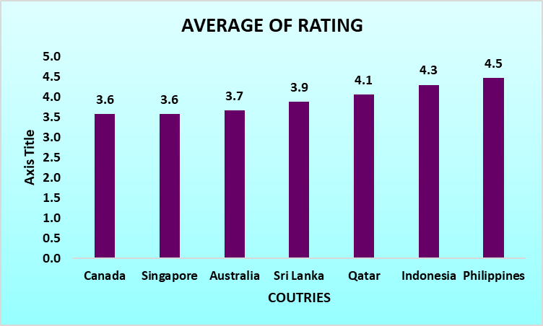
AVERAGE RATING OF RESTAURANTS IN SELECTED COUNTRIES
The ratings in the selected countries are in the range 2.9 to 4.3. The ratings are average giving insights that people are not fully satisfied with the restaurants
And hence its an opportunity for us to attract the people by providing the best of food and services.

Slide 12
EXPENDITURE ON FOOD
Country | Expenditure
Canada | 8,920.40
Australia | 31,489.44
Singapore | 192,133.20
Qatar | 101,895.75
Philippines | 52,318.0
Sri Lanka | 12,825.0
Indonesia | 31,296.50

Slide 13
COMPETITOR ANALYSIS
BIGGEST COMPETITORS WITH HIGHEST RATING
LESS COMPETITORS WITH LOW RATING
Bridge Road Brewers | 4.6
Gymkhana | 4.7
Le Petit Souffle | 4.8
Silantro Fil-Mex | 4.8
Sambo Kojin | 4.8
Talaga Sampireun | 4.9
Sushi Masa | 4.9
Talaga Sampireun | 4.9
Ooma | 4.9
Mainland China Restaurant | 4.9
Ministry of Crab | 4.9
Consort Restaurant | 3
Elite Indian Restaurant | 2.4
Makansutra Gluttons Bay | 3
Pier 70 | 2.6
Poets Cafe | 2.4
Queen's Cafe | 2.5
Star Buffet | 2.9

Slide 14

CUISINES WITH TOP RATINGS
These are the cuisines in the suggested seven countries with high number of ratings.
These are some cuisines in all the seven countries. It includes local food of that country and some other cuisines.
Top preference cuisines are Brazilian and Italian.
INDIAN 4.4
PIZZA 4.3
ASIAN 4.3
BRAZILIAN 4.5
AMERICAN 4.3
DESSERTS 4.3
ITALIAN 4.3

Slide 15
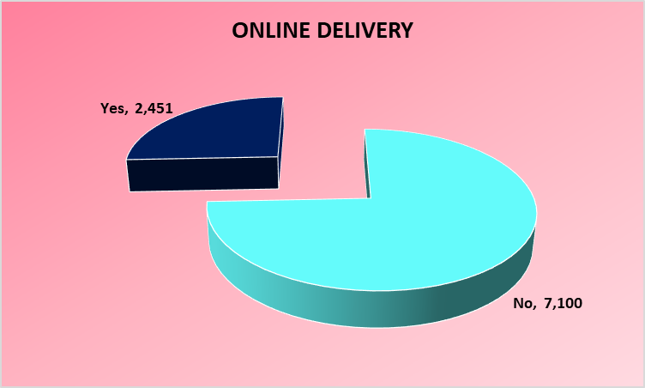
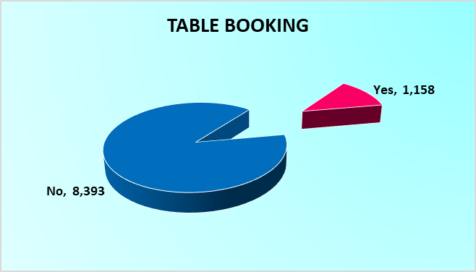
ONLINE DELIVERY /TABLE BOOKING
The selected seven countries provide the option of online delivery / table booking.
This could be an opportunity for us. A market survey could be done to get insights about the preferences of the people about these.
Cost vs. Services: Explore if there is a relationship between the cost for two and the availability of table booking or delivery services. Analyze whether customers are willing to pay more for the convenience of these services.

Slide 16
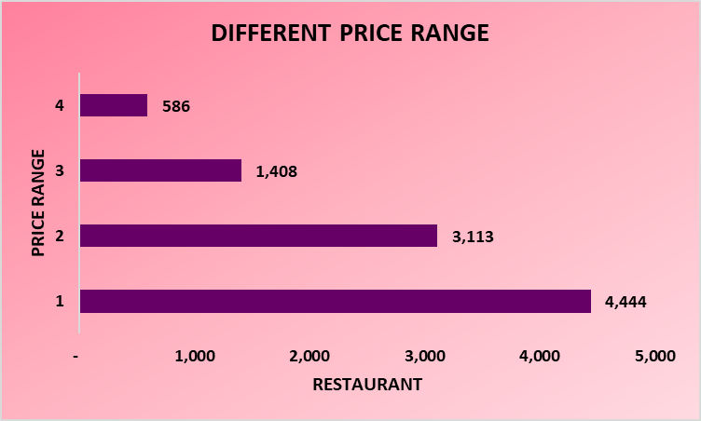
DIFFERENT PRICE RANGES
We create a pivot table for different price ranges to suggested countries and We make a stacked bar chart for it.
The 1 range has the highest value and range 4 has the least value in the chart.
.

Slide 17
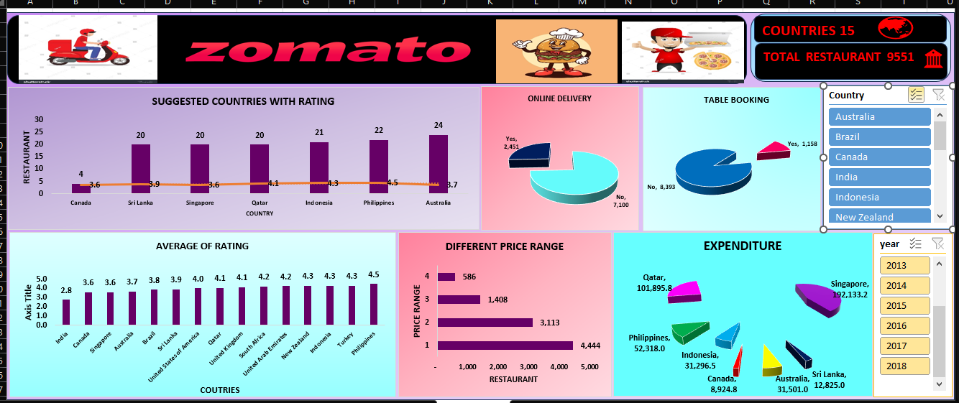
DASHBOARD

Slide 18
CONCLUSION :-
Holistic Approach: Zomato offers a comprehensive solution for restaurant management.
Streamlined Operations: Manages orders, tracks inventory, and simplifies workflows.
Data-Driven Decisions: Provides insights from customer feedback and sales for informed choices.
Stronger Customer Relationships: Analyzes feedback to improve interactions and foster loyalty.
Empowering Restaurant Owners: Equips them with the tools to optimize their business.
Future of Dining: Zomato exemplifies the positive impact of technology on the restaurant experience

Slide 19
THANK YOU

